Slide 1
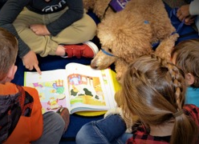
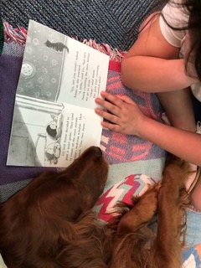
Pet Partners Tail Waggin’ Fun!
Sponsored By: Pet Partners Come meet 2 friendly therapy dogs: Megan, an Irish Setter, and Bailey, a Standard Poodle, and learn the difference between service and therapy animals. These two cute canines bring lots of tail-waggin’ fun to libraries in the area! Learn how you can build your confidence in reading and find a furry willing listener in Pet Partners’ pooch programs. https://petpartnersofprescott.weebly.com/
in person Event in memory park at : 9:30am! (11am for SELF Club)

