Slide 1
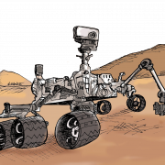
Mars Base Camp 4H Stem Challenge
Do you Have a teen/tween/Kid who Enjoys:
Science or Outer Space?
Board Games or Cards?
Coding or Computers?
Engineering or Robots?
…THEN JOIN US FOR A FREE SELF-SERVE MARS/STEM WORKSHOP!
ADULTS PLEASE PLAN TO PARTICIPATE, ESPECIALLY IF YOUR STUDENT IS YOUNGER, AS THEY MAY NEED ASSISTANCE. THANK YOU!
INCLUDES RAFFLE & TAKE-HOME ACTIVITY! DROP BY FRIDAY JULY 30TH, 2-5PM (1ST ANNIVERSARY OF MARS ROVER LAUNCH!)
CHINO VALLEY PUBLIC LIBRARY RLAURENCE@CHINOAZ.NET 102O W PALOMINO RD CV AZ 86323 928-636-9115

