Slide 1
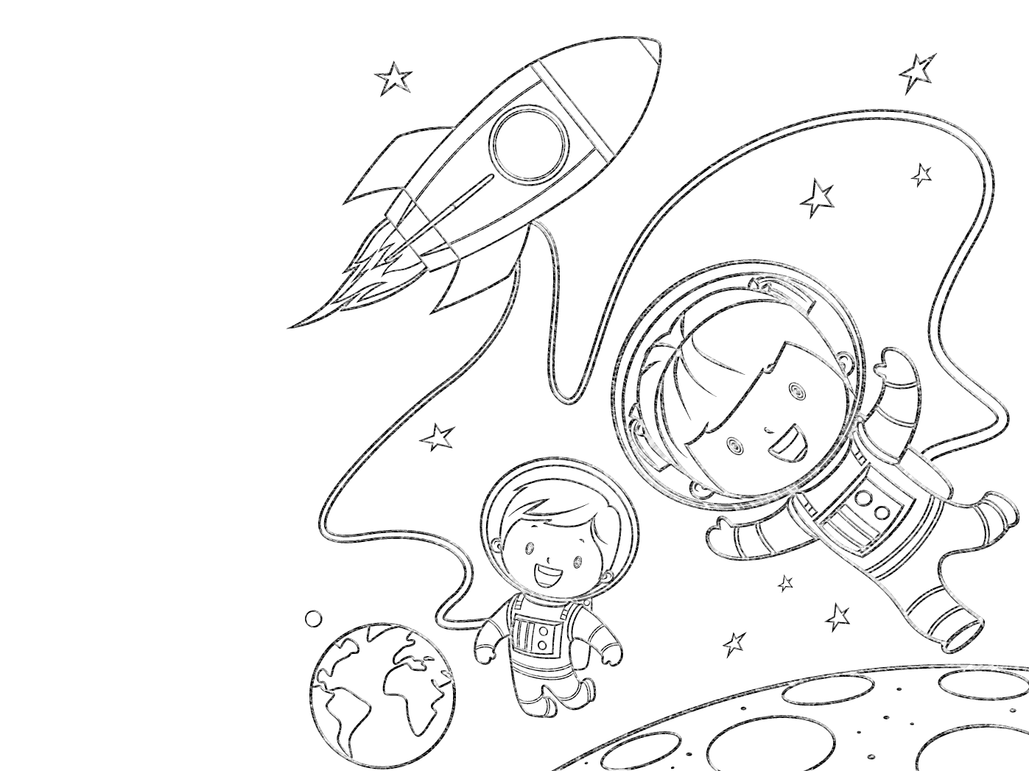



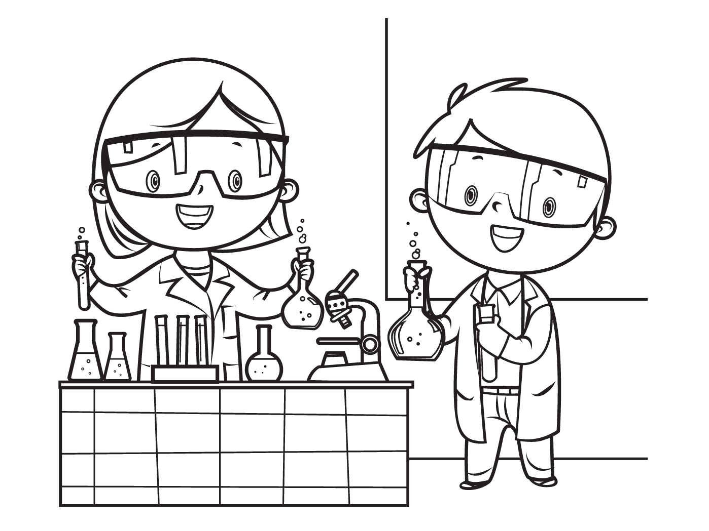

into
Science!
LEAP
FREE! Friday July 23, 2-5pm – In-Person - drop in anytime!
Explore the science of Light & Shadow through interactive hands-on activities & Kid’s books. Have fun while learning to think like scientists!
This event will be similar but slightly different than the past two Leap into Science events we had in May and June. You are welcome to participate
in all 3 or just this one!
Made possible by a grant from IMLS, special thanks to Friends
of the CV Library for their time and donations! http://leap.fi.edu/
& www.chinoaz.net/217/friends-of-the-library
Chino Valley Public Library 1020 W Palomino Rd CV, AZ 86323,
928-636-9115 www.chinoaz.net/216/childrens-library
Don’t miss our upcoming Mars Base Camp STEM Challenge! Stay Tuned!

